Slide 1
8-1 Adding and Subtracting Polynomials
Hubarth
Algebra

Slide 2
Monomial is an expression that is a number, a variable, or a product of a number and one or
more variables.
examples 12 y -5x²y $\frac{c}{3}$
Degree of a monomial is the sum of the exponents of its variables. Zero has no degree.
Ex 1 Degree of a Monomial
Find the degree of each monomial.
a. $\frac{2}{3}$x b. $7x^{2}y^{3}$ c. -4
a. Degree: 1
b. Degree: 5
c. Degree: 0

Slide 3
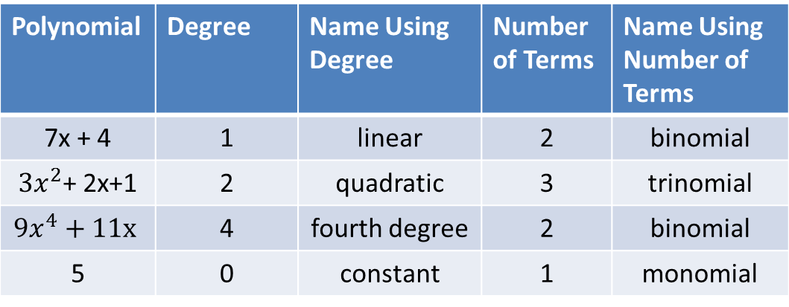
A polynomial is a sum of one or more monomials.
$$3x^{4}+5x^{2}−7x+1$$
degree 4 2 1 0
Standard Form of a polynomial means the degrees of the monomial terms decrease left to
right.
The degree of the polynomial is the degree of the monomial with the greatest exponent.
The degree of $3x^{4}+5x^{2}−7x+1$is 4
Polynomial | Degree | Name Using Degree | Number of Terms | Name Using Number of Terms
7x + 4 | 1 | linear | 2 | binomial
$3x^{2}$+ 2x+1 | 2 | quadratic | 3 | trinomial
$${9x}^{4}+11x$$ | 4 | fourth degree | 2 | binomial
5 | 0 | constant | 1 | monomial

Slide 4
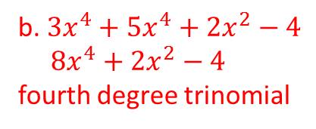
Ex 2 Classifying Polynomials
Write each polynomial in standard form. Then name each polynomial based on its degree
and the number of terms.
a. 5 – 2x b. ${3x}^{4}−4+{2x}^{2}+{5x}^{4}$
-2x + 5
linear binomial
b. ${3x}^{4}+{5x}^{4}+{2x}^{2}−4$
${8x}^{4}+{2x}^{2}−4$
fourth degree trinomial

Slide 5
Ex 3 Adding Polynomials
Simplify (6x² + 3x + 7) + (2x² – 6x – 4).
Method 1: Add vertically.
Line up like terms. Then add the coefficients.
6x² + 3x + 7
2x² – 6x – 4
8x² – 3x + 3
Method 2: Add horizontally.
Group like terms. Then add the coefficients.
(6x² + 3x + 7) + (2x² – 6x – 4) = (6x² + 2x²) + (3x – 6x) + (7 – 4)
= 8x² – 3x + 3

Slide 6
Ex 4 Subtracting Polynomials
Simplify (2x³ + 4x² – 6) – (5x³ + 2x – 2)
Method 1: Subtract vertically.
Line up like terms. Then add the coefficients.
(2x³ + 4x² – 6) Line up like terms.
–(5x³ + 2x – 2)
2x³ + 4x² – 6 Add the opposite.
–5x³ – 2x + 2
–3x³ + 4x² – 2x – 4
Method 2: Subtract horizontally.
(2x³ + 4x² – 6) – (5x³ + 2x – 2)
= 2x³ + 4x² – 6 – 5x³ – 2x + 2 Write the opposite of each term in the polynomial being subtracted.
= (2x³ – 5x³) + 4x² – 2x + (–6 + 2) Group like terms.
= –3x³ + 4x² – 2x – 4 Simplify.

Slide 7
Practice
Find the degree of -5x$y^{2}$.
2. Write the polynomial in standard form. Then name the polynomial based on its degree and
the number of its terms. ${6x}^{2}+7−9x^{4}$
3. Simplify each sum.
a. (12$m^{2}+4$) + (${8m}^{2}+5$) b. (${4p}^{4}+6p^{2}−10p$) + (${9p}^{3}+6p^{2}−8p+6$)
4. Simplify the difference.
a. (${30d}^{3}−29d^{2}−3d$) – (${2d}^{3}+d^{2}$)
3rd degree
${ −9x}^{4}+{6x}^{2}+7$ fourth degree trinomial
$${20m}^{2}+9$$
$${4p}^{4}+{9p}^{3}+12p^{2}−18p+6$$
$${28d}^{3}−30d^{2}−3d$$

