Slide 1
8-2 Multiplying and Factoring
Hubarth
Algebra

Slide 2
Ex 1 Multiplying a Monomial
Simplify –2g²(3g³ + 6g – 5)
= –2g²(3g³) –2g²(6g) –2g²(–5) Use the Distributive Property.
= –6g⁵ – 12g³ + 10g² Simplify.

Slide 3
Ex 2 Finding the Common Factor
Find the common factor of 2x⁴ + 10x² – 6x.
List the prime factors of each term. Identify the factors common to all terms.
2x⁴ = 2 • x • x • x • x
10x² = 2 • 5 • x • x
6x = 2 • 3 • x
The common factor is 2 • x, or 2x.

Slide 4
Ex 3 Factoring Out a Monomial
Factor 4x³ – 8x² + 12x.
Step 1: Find the common factor.
Step 2: Factor out the common factor.
4x³ = 2 • 2 • x • x • x
8x² = 2 • 2 • 2 • x • x
12x = 2 • 2 • 3 • x
4x³ – 8x² + 12x
= 4x(x²) + 4x(–2x) + 4x(3)
= 4x(x² – 2x + 3)
The common factor is 2 • 2 • x, or 4x.

Slide 5
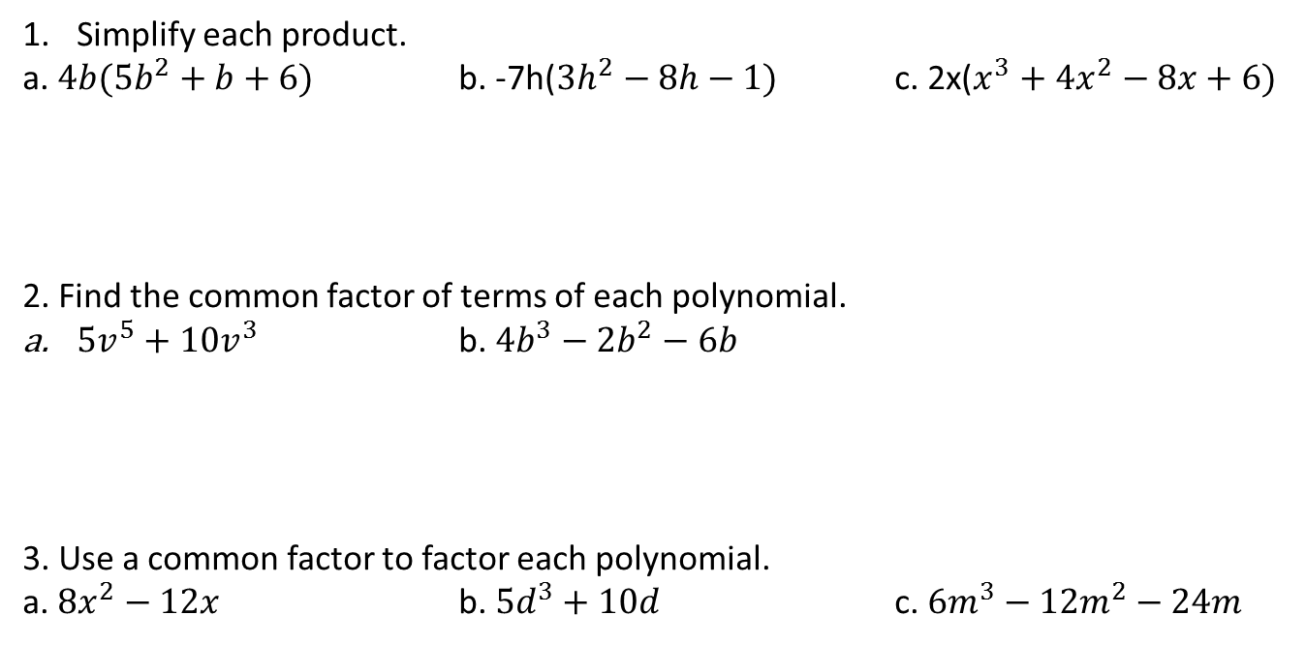
Practice
Simplify each product.
a. $4b(5b^{2}+b+6)$ b. -7h($3h^{2}−8h−1)$ c. 2x($x^{3}+4x^{2}−8x+6)$
2. Find the common factor of terms of each polynomial.
${5v}^{5}+10v^{3}$ b. ${4b}^{3}−2b^{2}−6b$
3. Use a common factor to factor each polynomial.
a. ${8x}^{2}−12x$ b. ${5d}^{3}+10d$ c. ${6m}^{3}−12m^{2}−24m$
$$20b^{3}+4b^{2}+24b$$
$$−21h^{3}+56h^{2}+7h$$
$$2x^{4}+8x^{3}−16x^{2}+12x$$
$${5v}^{3}$$
2b
4x(2x – 3)
5d($d^{2}+2)$
$$6m(m^{2}−2m−4)$$

