Slide 1
8-4 Multiplying Special Cases
Hubarth
Algebra

Slide 2
Squaring a Binomial
$${(a+b)}^{2} = a^{2}+2ab+b^{2}$$
$${(a−b)}^{2} =a^{2} −2ab+b^{2}$$
The square of a binomial is the square of the first term plus twice the product
of the two terms plus the square of the last.

Slide 3
Ex 1 Squaring a Binomial
a. Find (y + 11)².
(y + 11)² = y² + 2y(11) + 11²
= y² + 22y + 121
b. Find (3w – 6)².
(3w – 6)² = (3w)² –2(3w)(6) + 6²
= 9w² – 36w + 36

Slide 4
Ex 2 Mental Math
a. Find ${81}^{2}$ using mental math
81² = (80 + 1)²
= 80² + 2(80 • 1) + 1²
= 6400 + 160 + 1 = 6561
b. Find 59² using mental math.
59² = (60 – 1)²
= 60² – 2(60 • 1) + 1²
= 3600 – 120 + 1 = 3481

Slide 5
Difference of Squares
(a + b)(a – b) = $a^{2} −ab+ab −b^{2}$
= $a^{2} −b^{2}$
The product of the sum and difference of the same two terms is the difference
of their squares.

Slide 6
Ex 3 Finding the Difference of Squares
a. (p⁴ – 8)(p⁴ + 8).
(p⁴ – 8)(p⁴ + 8) = (p⁴)² – (8)²
= p⁸ – 64
b. (x – 1)(x + 1)
(x – 1)(x + 1) = $x^{2} −1^{2}$
= $x^{2} −1$

Slide 7
Ex 4 Mental Math
Find 43 • 37.
43 • 37 = (40 + 3)(40 – 3)
= 40² – 3²
= 1600 – 9 = 1591

Slide 8
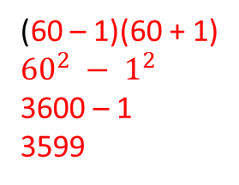
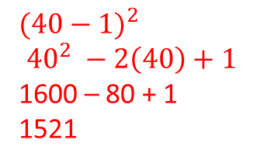
Practice
1. Find each square.
a. ${(t+6)}^{2}$ b. ${(8−3y)}^{2}$ c. ${(7m −2p)}^{2}$
$$t^{2}+12t+36$$
$$64 −48y+9y^{2}$$
$$49m^{2}−28mp+4p^{2}$$
2. Find each product.
a. (d + 11)(d – 11) b. ${(c}^{2}− 8){(c}^{2}+ 8 )$ c. ${(3x}^{2}−2y^{2})(3x^{2}+2y^{2})$
$$d^{2} −121$$
$$c^{4} −64$$
$$9x^{4}−4y^{4}$$
3. Use Mental Math
a. ${39}^{2}$ b. $59∙61$
$${(40−1)}^{2}$$
$${40}^{2} −2\left(40\right)+1$$
1600 – 80 + 1
1521
(60 – 1)(60 + 1)
$${60}^{2} − 1^{2}$$
3600 – 1
3599

